Slide 1
Storage Sizing and Placement in QuESt
Will Vining, Ujjwol Tamrakar, John Eddy
8812 Department Meeting
December 8, 2022

Slide 2

Objective
An open-source python-based simulation capability
Enhances the suite of tools included with QuESt by adding a discrete event simulation for evaluating the impact of energy storage on distribution grids that incorporates
grid physics
reliability
disruptions caused by extreme events
Provides a flexible architecture to support different simulations of weather, reliability, load management, energy storage, and other components
Support the optimization over multiple objectives
Optimize energy storage controls as well as size and placement

Slide 3
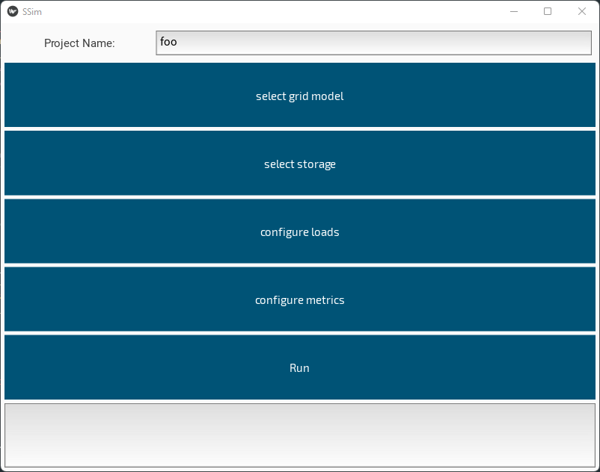
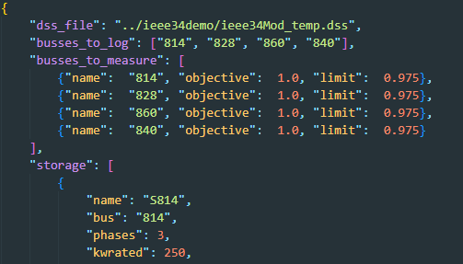
Usage
The simulator is configuration-driven
One config file specifies
the OpenDSS model
connected storage & PV
Reliability model parameters
etc.
Config files are JSON to enable human readability while keeping it easy to generate configurations from another program
A graphical UI is in development
Will enable an easy entry point for users via the QuESt tool

Slide 4
Example

Slide 5
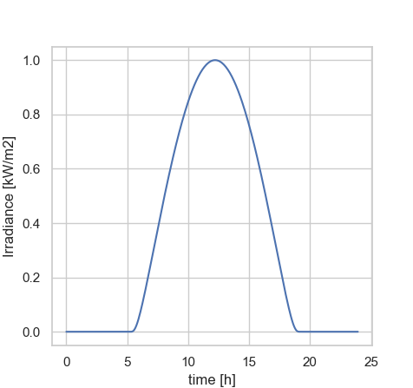
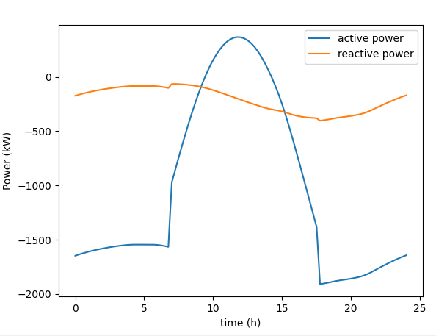
Storage for Voltage Regulation in IEEE 34 Bus Test Distribution System
Test Irradiance Profile
Bus 814, 828, 860, 840 are “critical” - we tolerate voltage between 0.972 and 1.025 p.u.
(arbitrary, just to demonstrate the configurability and flexibility of the metrics)
Question: What would be the size of storage required and where should it be placed?
Simulator utilized to analyze voltage regulation with PVs and explore few possible configurations of energy storage size/placements
Load Demand (Measured at Substation)
Power (kw/kVAr)

Slide 6
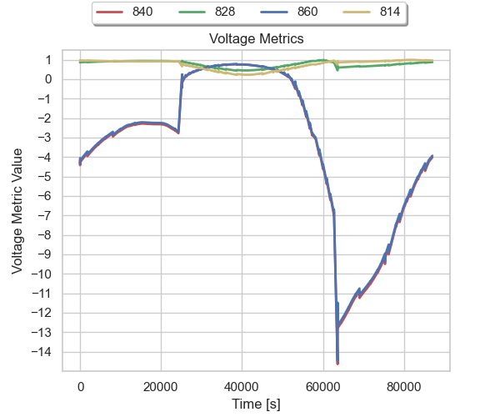
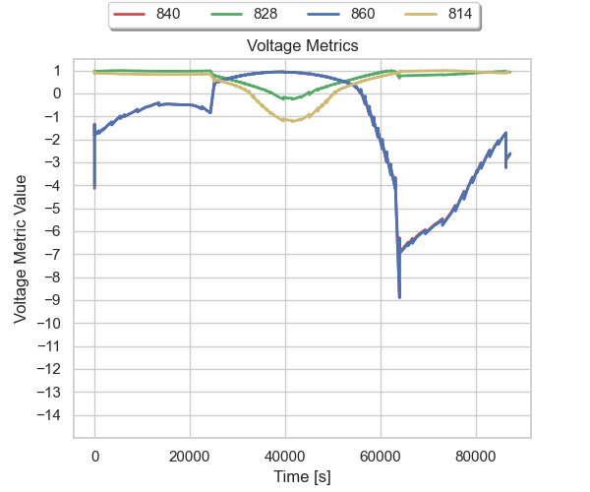
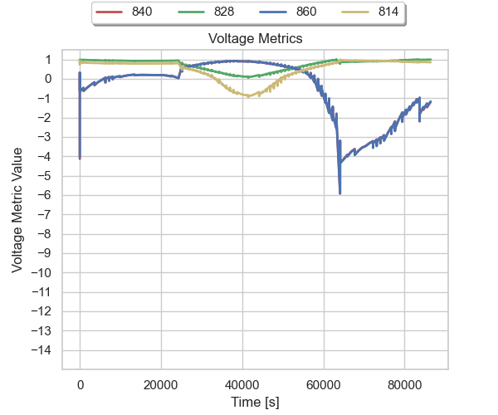
Voltage Metrics Based Comparison of Three Configurations
1 ESS Near Substation
Total Accumulated Metric Value = -1,474,596
2 ESS: Busses 814, 840
Total Accumulated Metric Value = -145,942
ESS at “Critical” Busses
Total Accumulated Metric Value = -14,316
Ideally this metric should be at 1.0
Approaches 0 as the value deviates from the target
As the value drifts beyond the limits the metric takes negative values
Configuration 2 and 3 seem to provide nearly identical performance – the accumulated metric clearly shows better performance of configuration 3

Slide 7
We are looking for case studies!
Any projects that could benefit from this kind of capability/analysis – please reach out
We would like some specific and realistic use cases to develop against for the next year

Slide 8
Backup

Slide 9

HELICS-based co-simulation
HELICS is used to couple several simulations
OpenDSS grid simulation
Grid reliability simulation
Multiple Storage controller simulations
Energy Management System simulation
A threat simulation
Multiple load simulations
Energy Management System
Reliability Simulation
Grid Simulation
(OpenDSS)
Storage Controller
Storage Controller
Storage Controller
Threat model
Load Simulation

Slide 10
Grid Simulation
storage controller
reliability
EMS
Input
Storage power set-points
Reliability events
EMS Actions
Output
Voltage at storage devices
Storage device status (SOC, current power output/demand, etc.)
Generator status (Current output, operating time, etc.)
PV system status (Current generation)
Total energy demand
HELICS
federate
new output
- voltages
- storage soc
- total load
- total generation
- next update time
update model
- storage power
- reliability events
- generator setpoints
- …
OpenDSS
Outputs detailed information about grid operation
Notes:
Advances time to the time of the next scheduled control action (or by a fixed interval if there are no pending actions)
When granted a time by HELICS
The OpenDSS model is updated to reflect changes to the boundary variables (storage power, reliability events)
Pending control actions are applied
Power flow is solved
Boundary variables are updated to reflect the new grid state
The requested time is pre-empted by
Changes to the output of the storage controllers
Reliability events (component failures and restorations)
Commands from the EMS

Slide 11
Reliability Model
grid
EMS
Threat
Input
Status updates for grid components
Output
Failure events
Repair events
Simple probabilistic failure model
Can be easily replaced with different models
Will respond to input from the threat federate to activate fragility models for grid components.
HELICS
federate
Component
Status from grid (e.g. generator run time)
Current threat information
Reliability events
- failure/repair events @
present time
- time of the next event/update
reliability model
Notes:
The reliability model observes the operation of the grid, updating probabilistic failure models and generating failure events when they are indicated by the models.

Slide 12
Storage Controller
grid
EMS
Inputs
Voltage
State of Charge
Control messages from EMS
Outputs
Power set-point (Real/Reactive)
Status messages to EMS
Each storage device has its own external controller. This supports:
Independently controlled storage devices
Globally controlled devices (i.e. controlled by an EMS)
HELICS
federate
- voltage
- state of charge
- EMS commands
- power set-point
- status
controller model

Slide 13
EMS Design (in development)
storage controller
reliability
grid
Inputs
Current generator output
Current demand
Reliability events
Outputs
Control actions to storage controllers
Control actions to grid model (generator setpoint changes, switch actions, etc.)
Have implemented a simple heuristic-based EMS. We are in the process of integrating an EMS that combines OPF and heuristics for better control.
The modular architecture means using a different EMS can be a relatively simple task.
HELICS
federate
update model
- grid element status
- reliability events
output
- ESS setpoints
- Generator setpoints
- Switch changes
EMS
Record grid state and power quality statistics

Slide 14
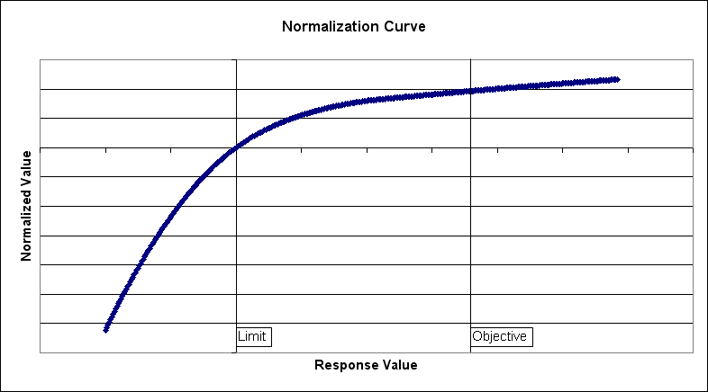
Quantifying Performance
The grid simulation is configured to report measurements at specific locations to a “metrics federate”
Each measured value is assigned target values (limit and objective) and an improvement type (minimize, maximize, seek-value).
The metrics federate normalizes the values it receives using a non-linear normalization curve with specific properties to support optimization over many (hundreds or thousands) of values.
Normalized metrics allow different quantities of interest to be compared directly. For example, we can examine trade offs between voltage across the grid, line loading, energy service, or any other quantity of interest.
Piecewise quadratic
Monotonically decreasing slope
Continuous

Slide 15
Reliability Example

Slide 16
Reliability Example
Generator added to the IEEE13 node system at bus 675.
Constant 2 MW output
A Storage system is added at bus 670
32 MWh
1.2 MW
50% initial SOC
Dispatched internally by OpenDSS based on power flow at bus 632 (no controller federate)
Failure of the upstream switch connecting the generator to the rest of the grid is simulated
650
646
645
632
633
634
1.2
MW
670
switch fails open
,
32
MWh
611
684
ESS
671
692
675
3
MWp
2 MW
652
680

Slide 17
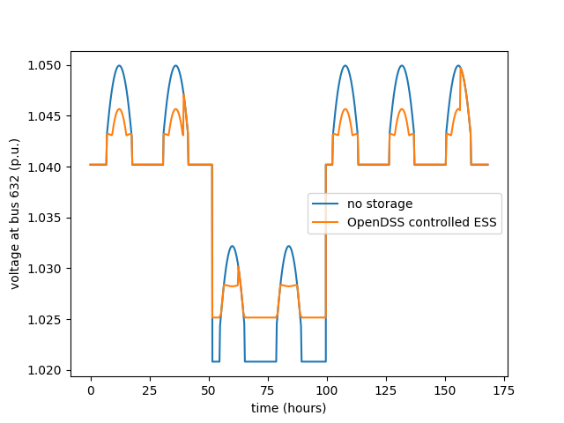
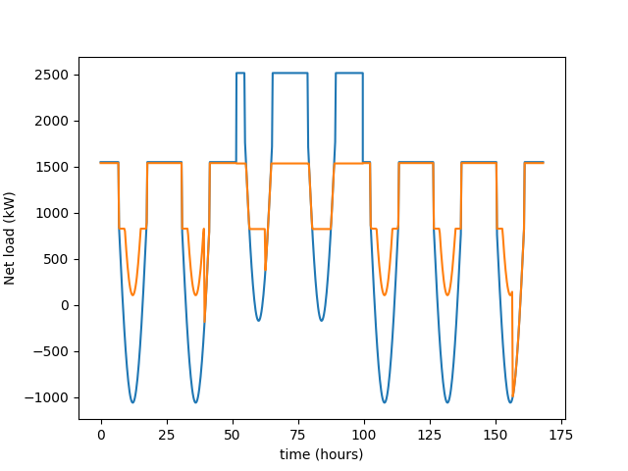
Reliability Example - results
ESS consumes excess generation from PV system until it is fully charged
Switch fails at hour 50, disconnecting the generator
ESS picks up the lost generation
Switch is repaired 48 hours later and the ESS again re-charges from excess PV generation

Slide 18
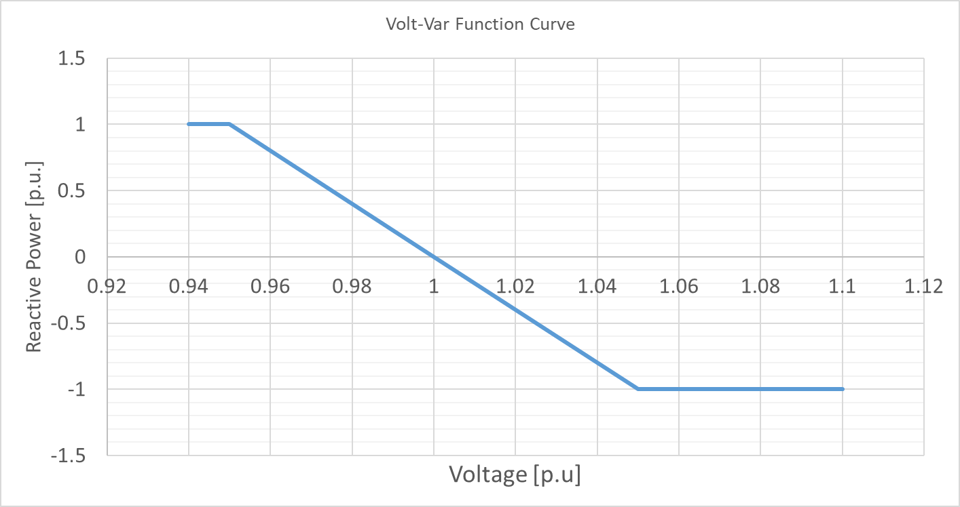
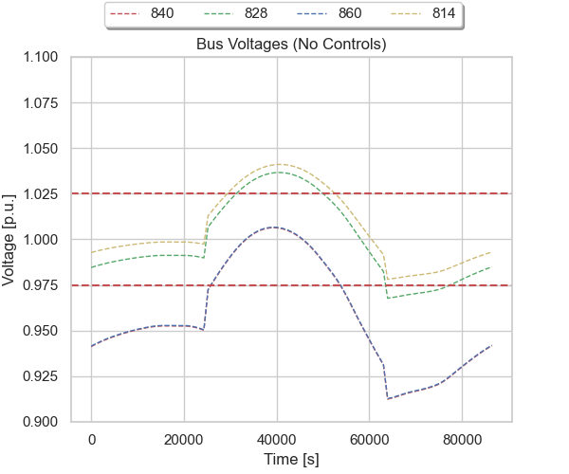
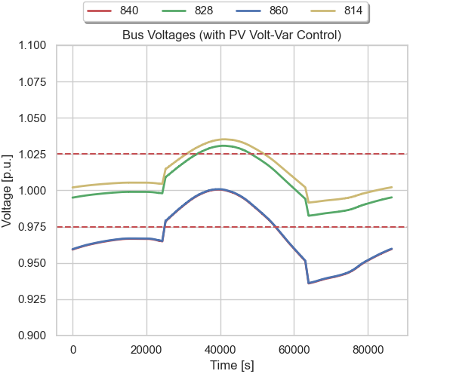
Analyzing the Impact of Volt-Var Function
According to IEEE 1547-2018 standard for interconnection of DERs, PV inverters need to provide grid support functions such as volt-var
Simulator has the ability to enable such inverter functions
PVs 850 and 860 are assumed to be capable of providing volt-var support
Other PVs are considered to be older units
Operating with MPPT injecting all the available active power
Capacitive Vars
Inductive Vars
Volt-var functions provide some level of voltage regulation – not enough on its own.

Slide 19
Configuration 1 : Single Energy Storage Near Substation
Droop Controller
Single energy storage placed at bus 814 for voltage regulation
Energy storage operates on a “droop-based” control strategy based on voltage measurement obtained at bus 814
Relatively high gains were used to achieve desired voltage regulation

Slide 20
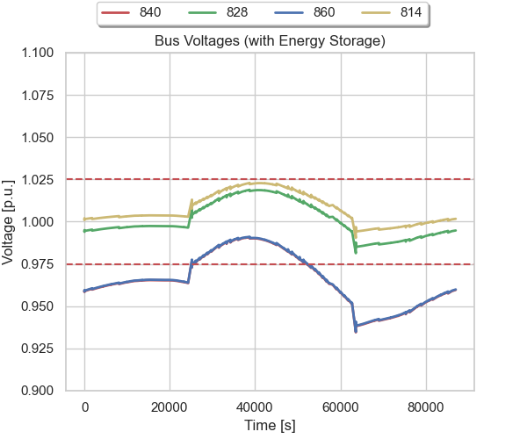
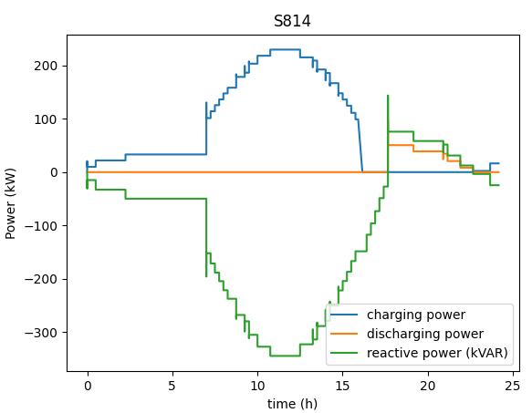
Configuration 1 – Voltages at “Critical” Buses
A 450 kW, 1500 kWh energy storage unit able to prevent overvoltage at buses 814 and 828
These buses are near the energy storage installation
Difficult to regulate voltage at the end of the feeder (buses 840 and 860) with a single energy storage at bus 814
450 kW, 500 kVA
~1500 kWh

Slide 21
Configuration 2: Two Energy Storage Units
Two storage units placed at buses 814 (near substation)and 840 (end of feeder)
Volt-Var function only active in PV @ 850 and 860

Slide 22
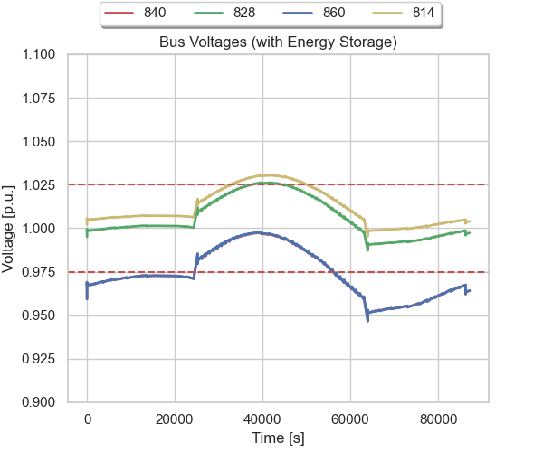
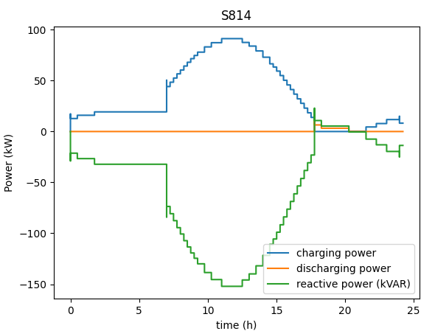
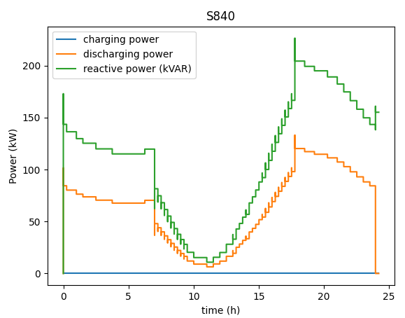
Configuration 2- Voltage at “Critical” Buses
Voltage regulation nearly within desired limits of 0.975-1.025 p.u with two storage units
175 kW, 200kVA
~1800 kWh
250 kW, 275kVA
~750 kWh

Slide 23
Configuration 3: Energy Storage Placed at Each “Critical” Bus
Placed 4- smaller sized distributed energy storage units at these critical buses
Droop control implemented in each energy storage based on local voltage measurements

Slide 24
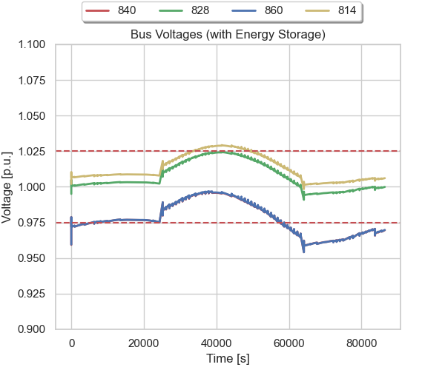
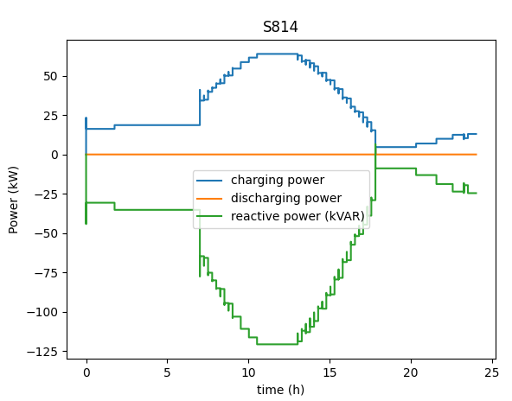
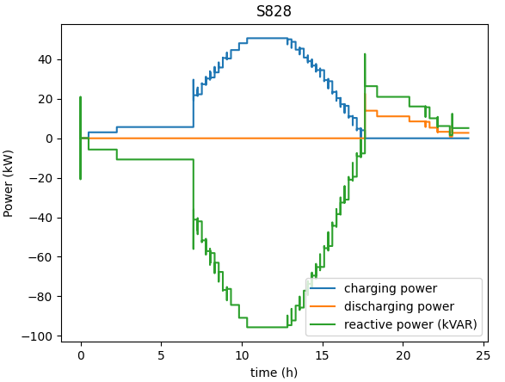
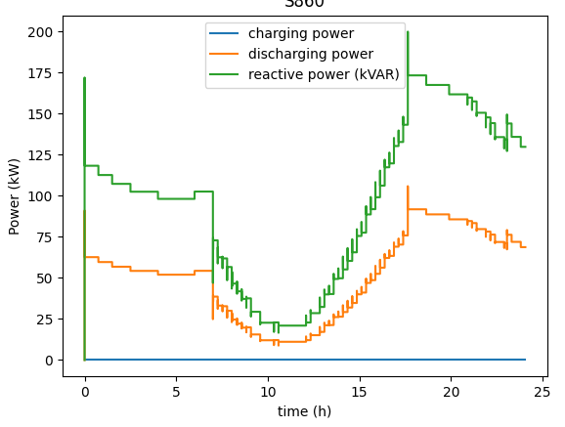
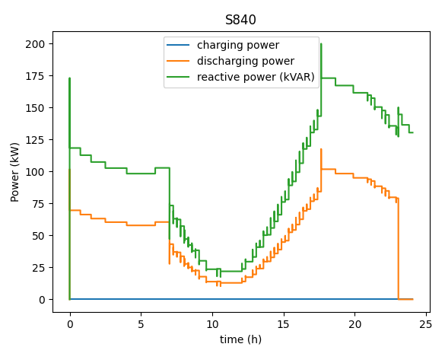
Configuration 3– Voltage on Critical Buses
Slightly better voltage regulation compared to case with configuration 2
150 kW, 175kVA
~650 kWh
150 kW, 175kVA
~350 kWh
250 kW, 275kVA
~1500 kWh
250 kW, 275kVA
~1500 kWh

